Slide 1
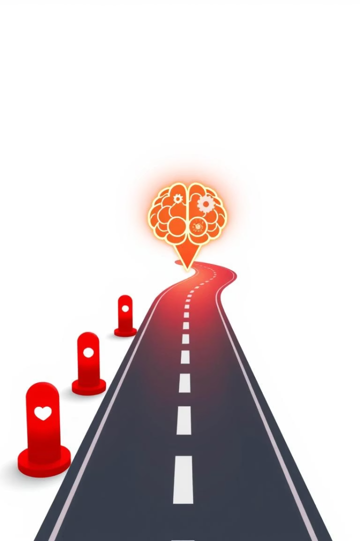
Your Journey: A Friendly Roadmap to Personalized Learning with ML
Ready to dive into the exciting world of Machine Learning? This roadmap is your super-friendly guide to building a cool project focused on personalized learning. We'll keep things simple and fun, so you can get your hands dirty without feeling overwhelmed.
Created By Dishari Dutta Chowdhury

Slide 2
What's This Al About?
Personalized Learning
Why Bring in ML?
Imagine learning custom-fit just for you. It's like having a tutor who knows exactly what you need and how you learn best.
Machine Learning acts as a super-smart detective. It analyzes student data to spot patterns.
These patterns help make smart recommendations, making learning personal and effective.
We tailor lessons, pace, and teaching style to your unique needs.

Slide 3

Your Project Goal: A Simple Content Buddy
Build a Basic System
Based on Past Performance
Create a system that recommends learning materials (articles, videos, exercises) to students.
Suggestions will be based on how students performed previously or their stated preferences.
Example: Python Learning
If you struggle with loops or ace functions, the system suggests the perfect next step or resource.

Slide 4
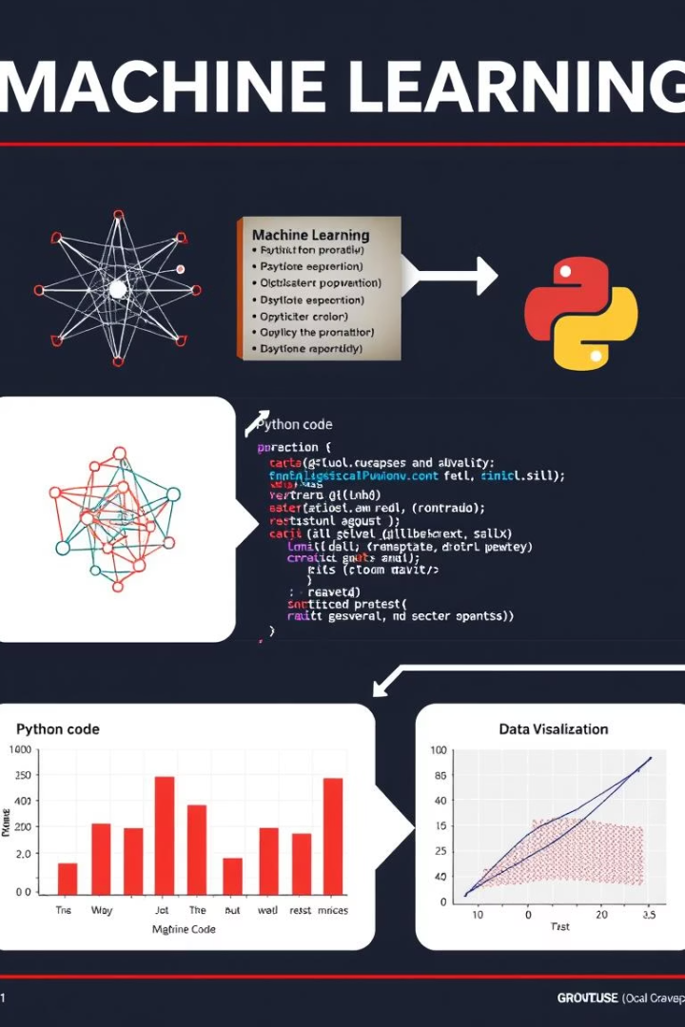



The Basics You'll Learn & Use
Machine Learning Ideas
Python Language
Handy Toolkits
Use pandas for data, scikit-learn for ML algorithms, and matplotlib/seaborn for charts.
Learn supervised learning, features, labels, training, testing, overfitting, and recommendation systems.
Python is popular in ML and beginner-friendly.

Slide 5




Step-by-Step: Let's Build This!
Pin Down Your Problem & Info
Decide what learner info to collect: student_id, topic, score, time_spent, liked_topic, recommended_next_topic.
Gather (or Make Up!) Your Data
Create a small, fake dataset (50-100 rows) in a CSV or Python list for practice.
Clean Up Your Data
Load into pandas, fill blanks, ensure correct types, and translate text categories to numbers using encoding.

Slide 6
Building Your Smart Recommendation Engine
Crafting New Clues
1
Create smarter clues like score_per_minute from existing data.
2
Divide and Conquer
Split data (70-80% training, rest testing) to prevent memorization.
Picking Your ML Brain
3
Choose K-Nearest Neighbors or Decision Tree for categories, Linear Regression for numbers.
4
Teaching Your Model
Train your model with the training data.
Grading Your Model's Homework
5
Test predictions on unseen data. Use accuracy/confusion matrix for categories, MAE/MSE for numbers.

Slide 7

Making It Work & Making It Better
Personalized Recommendations
Write code to feed new student info to your trained model for recommendations.
Simple Launch
Save your trained model using joblib or pickle to avoid retraining. Create a basic command-line tool.
Keeping an Eye & Getting Better
Continuously check if recommendations help students. Collect more data and retrain for smarter systems.

Slide 8








Your Learning Buddies (Tools & Resources)
Online Learning
Documentation
Coursera (Andrew Ng), freeCodeCamp, DataCamp offer great courses.
The scikit-learn website provides clear explanations and examples.
Books
Playgrounds
"Hands-On Machine Learning with Scikit-Learn, Keras, and TensorFlow" is a popular choice.
Jupyter Notebooks or Google Colab are perfect for coding and seeing results.

Slide 9






Friendly Tips for Your Journey!
Go Small to Go Big
Know Your Data
Focus on one small step at a time, don't try to build Netflix immediately.
Spend time understanding your created data; it's key.
Code in Little Bites
Bugs Are Teachers
Write, test, and ensure small code bits work before adding more.
Error messages guide you; read them carefully.
Internet is Your Friend
Patience is a Virtue
Google, Stack Overflow, and online communities have answers.
ML takes time to click; celebrate every tiny win!

